Slide 1
Arithmetic Statistics in Function Fields

Slide 2
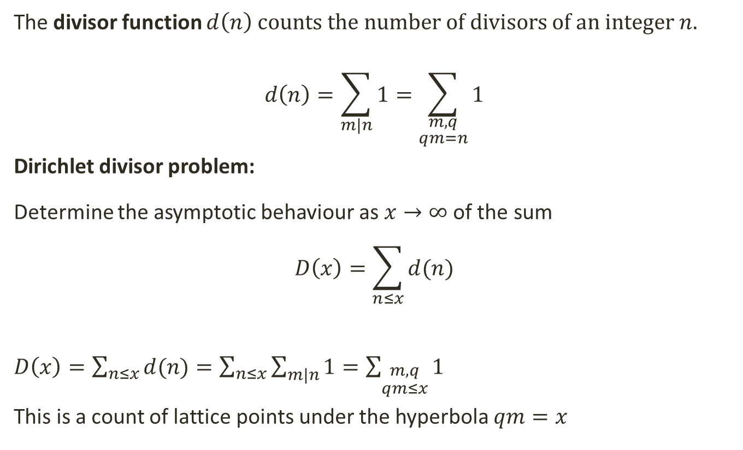
The Divisor function
The divisor function $d\left(n\right)$ counts the number of divisors of an integer $n$.
$$d\left(n\right)=\sum_{m|n}{1}=\sum_{\begin{aligned}m,q \\ qm=n\end{aligned}}{1}$$
Dirichlet divisor problem:
Determine the asymptotic behaviour as $x→∞$ of the sum
$$D\left(x\right)=\sum_{n≤x}{d(n)}$$
$D\left(x\right)=\sum_{n≤x}{d(n)}=\sum_{n≤x}{\sum_{m|n}{1}}=\sum_{\begin{aligned}m,q \\ qm≤x\end{aligned}}{1}$
This is a count of lattice points under the hyperbola $qm=x$
Notes:
Give an example

Slide 3
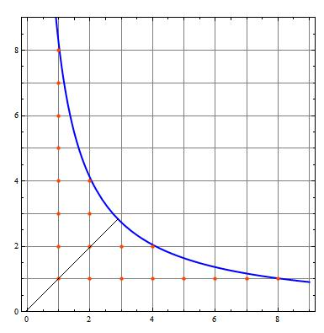
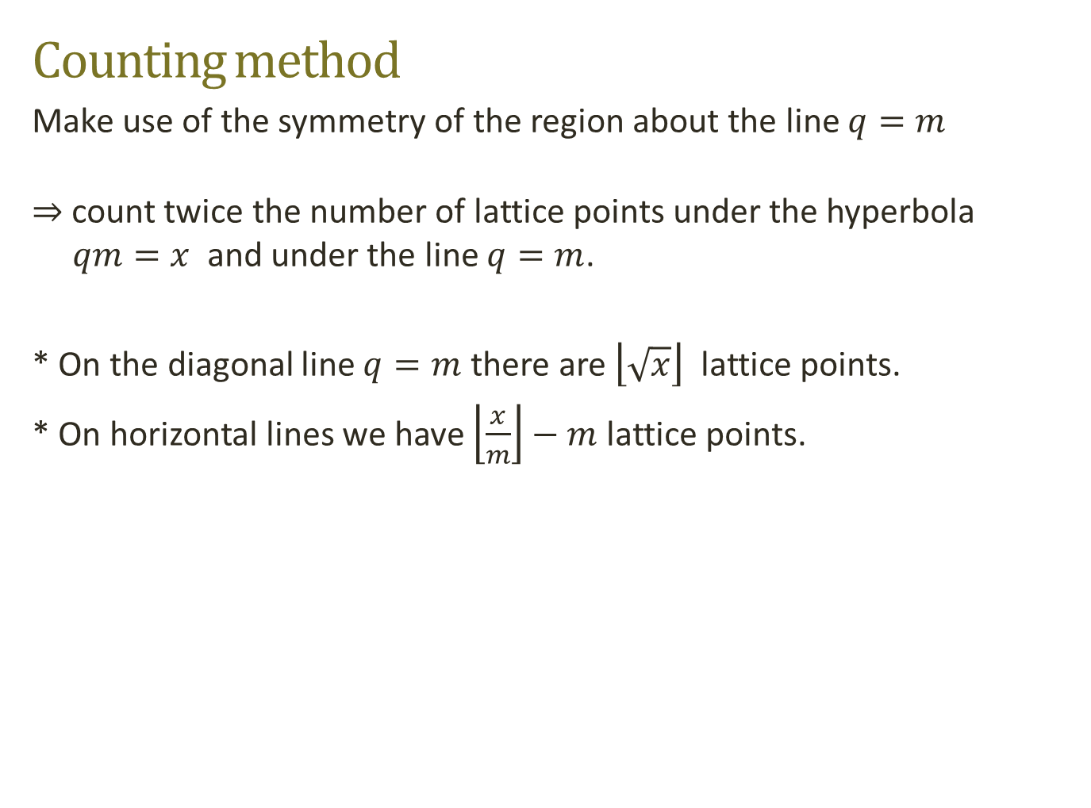
Counting method
Make use of the symmetry of the region about the line $q=m$
$⇒$count twice the number of lattice points under the hyperbola $qm=x$and under the line $q=m$.
* On the diagonal line $q=m$ there are $\left\lfloor \sqrt{x}\right\rfloor$lattice points.
* On horizontal lines we have $\left\lfloor \frac{x}{m}\right\rfloor −m$lattice points.

Slide 4
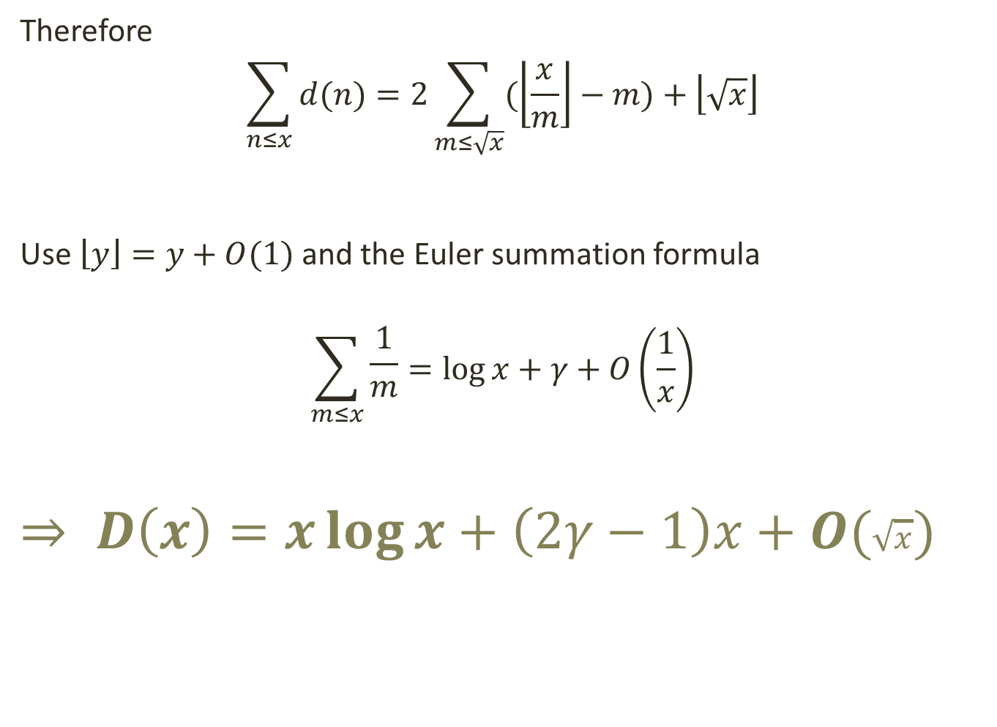
Therefore
$$\sum_{n≤x}{d(n)}=2\sum_{m≤\sqrt{x}}{(\left\lfloor \frac{x}{m}\right\rfloor −m)}+\left\lfloor \sqrt{x}\right\rfloor$$
Use $\left\lfloor y\right\rfloor =y+O(1)$ and the Euler summation formula
$$\sum_{m≤x}{\begin{aligned}\frac{1}{m} \\ \end{aligned}}=\log{x}+γ+O\left(\frac{1}{x}\right)$$
$$⇒ D\left(x\right)=x\log{x}+\left(2γ−1\right)x+O(\sqrt{x})$$

Slide 5
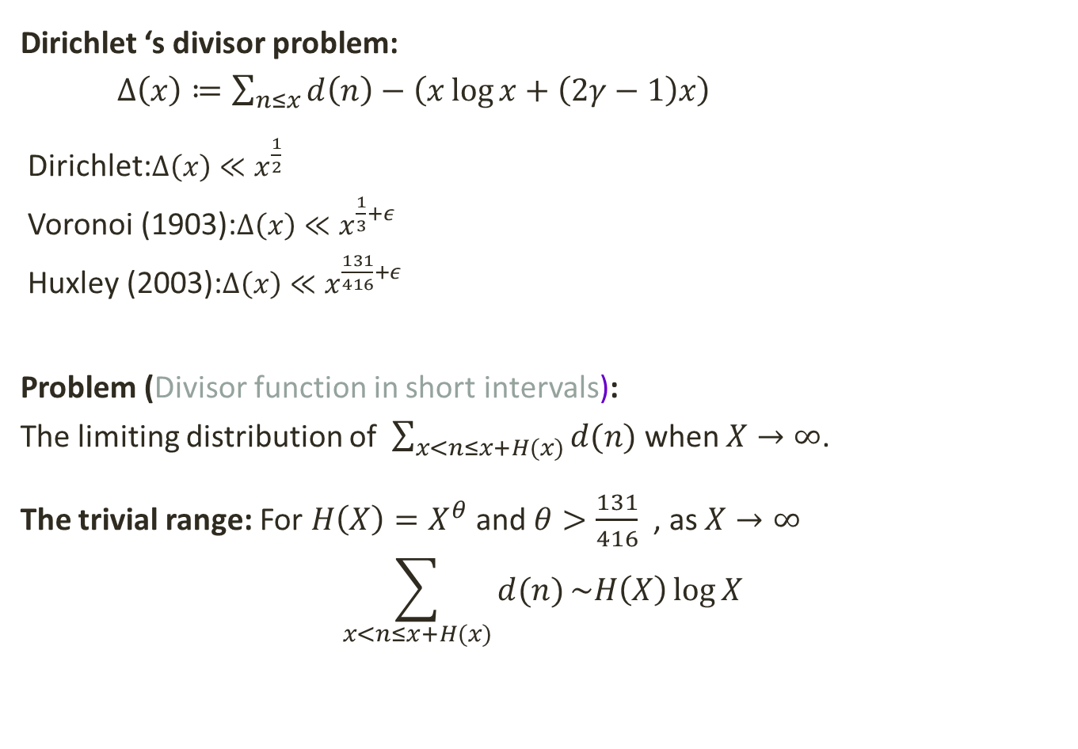
Dirichlet ‘s divisor problem:
$Δ\left(x\right)≔\sum_{n≤x}{d\left(n\right)}−\left(x\log{x}+\left(2γ−1\right)x\right)$
Dirichlet:$Δ\left(x\right)≪x^{\frac{1}{2}}$
Voronoi (1903):$Δ\left(x\right)≪x^{\frac{1}{3}+ε}$
Huxley (2003):$Δ\left(x\right)≪x^{\frac{131}{416}+ε}$
Problem (Divisor function in short intervals):
The limiting distribution of $\sum_{x<n≤x+H(x)}{d(n)}$ when $X→∞$.
The trivial range: For $H\left(X\right)=X^{θ}$ and $θ>\frac{131}{416}$ , as $X→∞$
$$\sum_{x<n≤x+H(x)}{d(n)}\sim H\left(X\right)\log{X}$$

Slide 6

The Divisor function in short intervals
Define$Δ\left(x;H\right)$=$Δ\left(x+H\right)−Δ\left(x\right)$
Ivic (2009): For $X^{ε}<H<\frac{1}{2}X^{\frac{1}{2}−ε}$
$\frac{1}{X}\int_{X}^{2X}{{\left(Δ\left(x;H\right)\right)}^{2}dx\sim HP_{3}(\log{x−2\log{H}})}$
with $P_{3}$ a certain cubic polynomial.

Slide 7
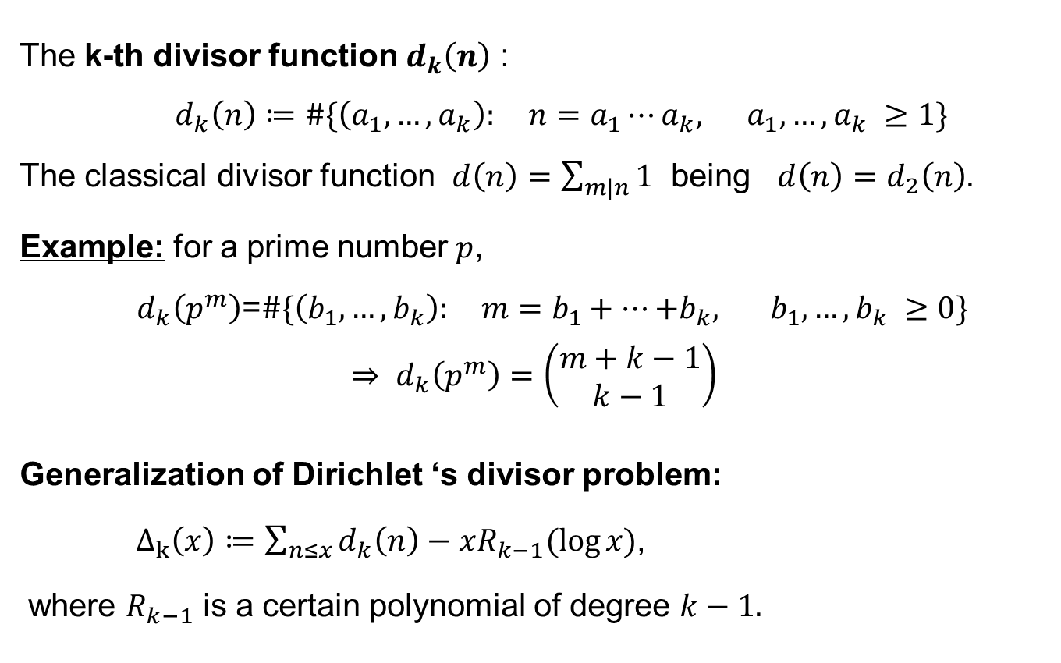
The generalized Divisor function
The k-th divisor function $d_{k}\left(n\right)$ :
$d_{k}\left(n\right)≔\#\{\left(a_{1},…,a_{k}\right): n=a_{1}⋯a_{k}, a_{1},…,a_{k} ≥1\}$
The classical divisor function $d\left(n\right)=\sum_{m|n}{1}$ being $d\left(n\right)=d_{2}\left(n\right).$
Example: for a prime number $p$,
$d_{k}\left(p^{m}\right)$=$\#\{\left(b_{1},…,b_{k}\right): m=b_{1}+⋯{+b}_{k}, b_{1},…,b_{k} ≥0\}$
$$⇒ d_{k}\left(p^{m}\right)=\left(\begin{aligned}m+k−1 \\ k−1\end{aligned}\right)$$
Generalization of Dirichlet ‘s divisor problem:
$Δ_{k}\left(x\right)≔\sum_{n≤x}{d_{k}\left(n\right)}−xR_{k−1}(\log{x)}$,
where $R_{k−1}$ is a certain polynomial of degree $k−1.$
Notes:
I will start by defining…
Delta 2 is the error term in evaluating the sum of the classical divisor function up to x by x times a acertain linear poly in log x

Slide 8
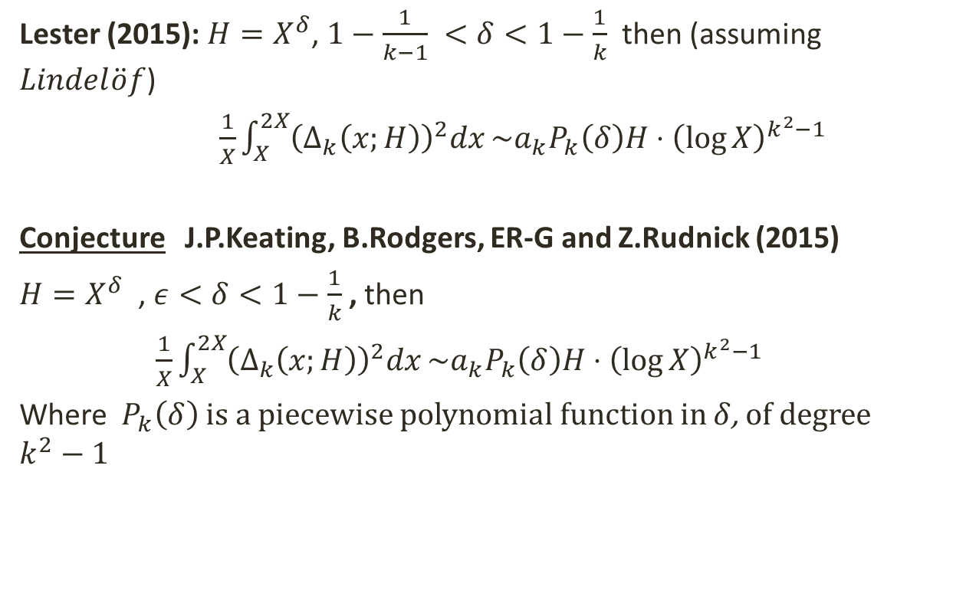
The generalized Divisor function in short intervals
Lester (2015):$H=X^{δ}$, $1−\frac{1}{k−1} <δ<1−\frac{1}{k}$ then (assuming $Lindel\ddot{o}f$)
$\frac{1}{X}\int_{X}^{2X}{{\left(Δ_{k}\left(x;H\right)\right)}^{2}dx}\sim {a_{k}P}_{k}\left(δ\right)H⋅{\left(\log{X}\right)}^{k^{2}−1}$
Conjecture J.P.Keating, B.Rodgers, ER-G and Z.Rudnick (2015)
$H=X^{δ}$ , $ε<δ<1−\frac{1}{k}$ , then
$\frac{1}{X}\int_{X}^{2X}{{\left(Δ_{k}\left(x;H\right)\right)}^{2}dx}\sim {a_{k}P}_{k}\left(δ\right)H⋅{\left(\log{X}\right)}^{k^{2}−1}$
Where ${ P}_{k}\left(δ\right)$ is a piecewise polynomial function in $δ$, of degree $k^{2}−1$

Slide 9
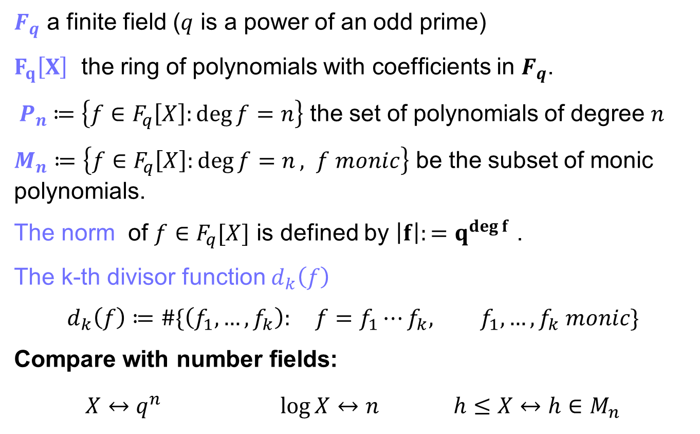
Function fields
$F_{q}$ a finite field ($q$ is a power of an odd prime)
$F_{q}\left[X\right]$ the ring of polynomials with coefficients in $F_{q}$.
${ P}_{n} ≔\left\{f∈F_{q}\left[X\right]:\deg{f=n}\right\}$ the set of polynomials of degree $n$
$M_{n}≔\left\{f∈F_{q}\left[X\right]:\deg{f=n}, f monic\right\}$ be the subset of monic polynomials.
The norm of ${f∈F}_{q}[X]$ is defined by $\left|f\right|:=q^{\deg{f}}$ .
The k-th divisor function $d_{k}\left(f\right)$
$$d_{k}\left(f\right)≔\#\{\left(f_{1},…,f_{k}\right): f=f_{1}⋯f_{k}, f_{1},…,f_{k} monic\}$$
Compare with number fields:
$X↔q^{n}$ $\log{X↔n }$ $h≤X↔h∈M_{n}$

Slide 10
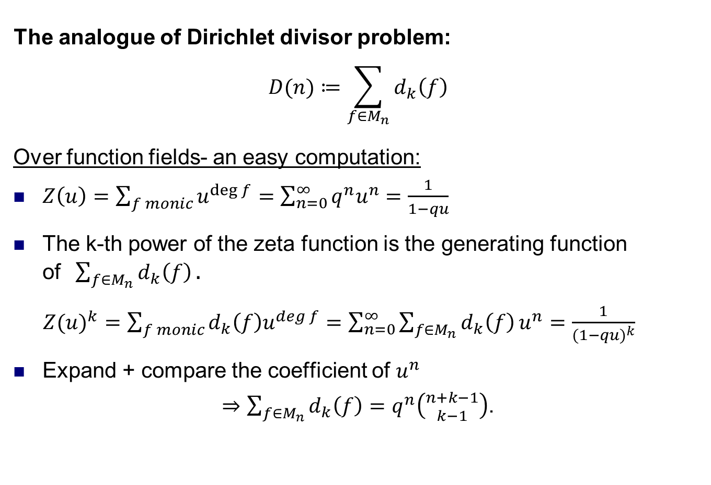
Divisors in function fields
The analogue of Dirichlet divisor problem:
$$D(n)≔\sum_{f∈M_{n}}{d_{k}\left(f\right)}$$
Over function fields- an easy computation:
$Z\left(u\right)=\sum_{f monic}{u^{\deg{f}}}=\sum_{n=0}^{∞}{q^{n}u^{n}}=\frac{1}{1−qu}$
The k-th power of the zeta function is the generating function of$\sum_{f∈M_{n}}{d_{k}\left(f\right)}.$
${Z(u)}^{k}=\sum_{f monic}{d_{k}\left(f\right)u^{\deg{f}}}=\sum_{n=0}^{∞}{\sum_{f∈M_{n}}{d_{k}\left(f\right)}u^{n}}=\frac{1}{{(1−qu)}^{k}}$
Expand + compare the coefficient of $u^{n}$
$⇒\sum_{f∈M_{n}}{d_{k}\left(f\right)}=q^{n}\left({n+k−1 \atop k−1}\right)$.

Slide 11

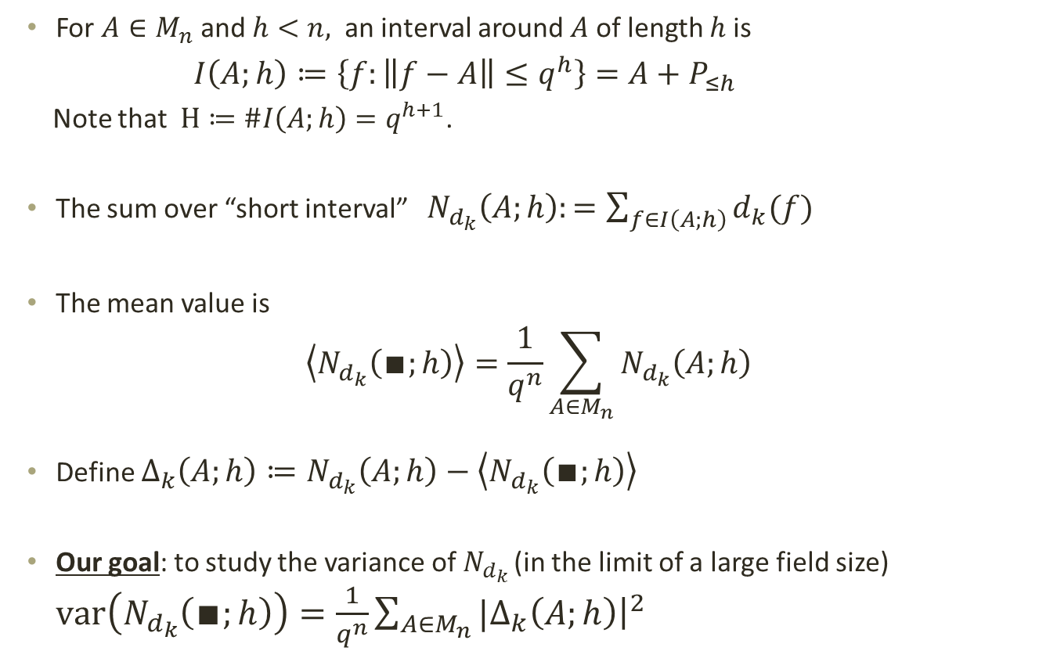
Short intervals in $F_{q}[X]$
For $A∈M_{n}$ and $h<n,$ an interval around $A$ of length $h$ is
$I\left(A;h\right)≔\left\{f:\left\|f−A\right\|≤q^{h}\right\}=A+P_{≤h}$
Note that $H≔\#I\left(A;h\right)=q^{h+1}$.
The sum over “short interval” $N_{d_{k}}\left(A;h\right):=\sum_{f∈I\left(A;h\right)}{d_{k}(f)}$
The mean value is
$$\left\langle N_{d_{k}}\left(∎;h\right)\right\rangle =\frac{1}{q^{n}}\sum_{A∈M_{n}}{N_{d_{k}}\left(A;h\right)}$$
Define $Δ_{k}\left(A;h\right)≔N_{d_{k}}\left(A;h\right)−\left\langle N_{d_{k}}\left(∎;h\right)\right\rangle$
Our goal: to study the variance of $N_{d_{k} }$(in the limit of a large field size) $var\left(N_{d_{k}}\left(∎;h\right)\right)=\frac{1}{q^{n}}\sum_{A∈M_{n}}{|{\left.Δ_{k}\left(A;h\right)​\right|}^{2}}$

Slide 12
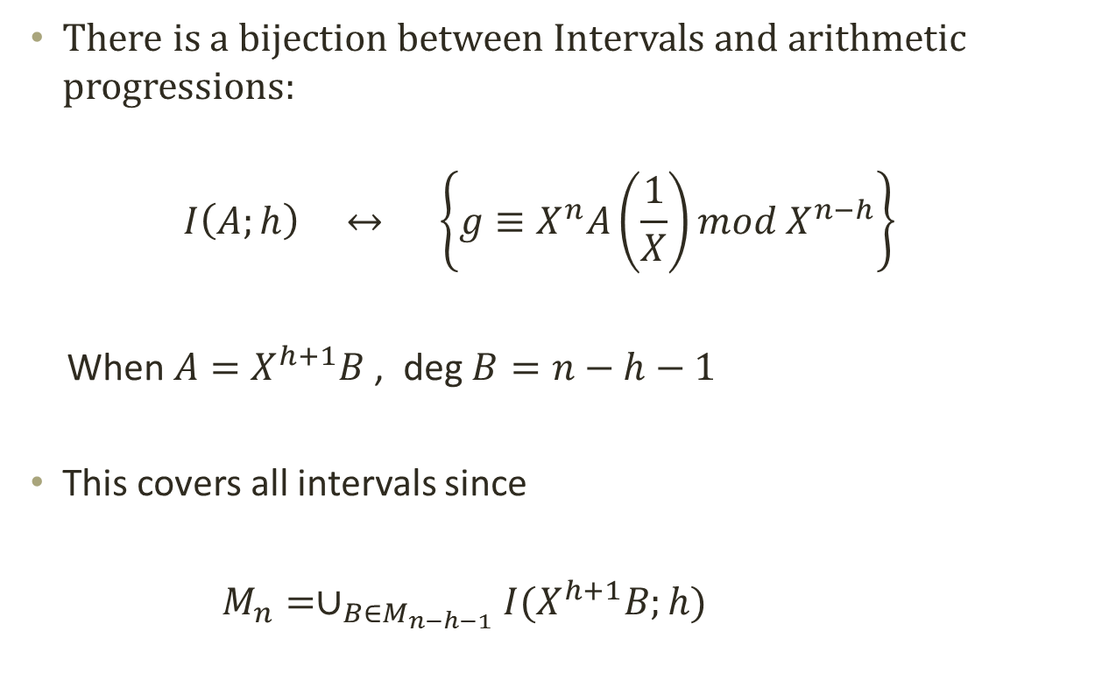
Short intervals as arithmetic progressions
There is a bijection between Intervals and arithmetic progressions:
$$I\left(A;h\right) ↔ \left\{g≡X^{n}A\left(\frac{1}{X}\right)mod X^{n−h}\right\}$$
When $A=X^{h+1}B$ , deg $B=n−h−1$
This covers all intervals since
$M_{n}=∪_{B∈M_{n−h−1}}I(X^{h+1}B;h)$

Slide 13
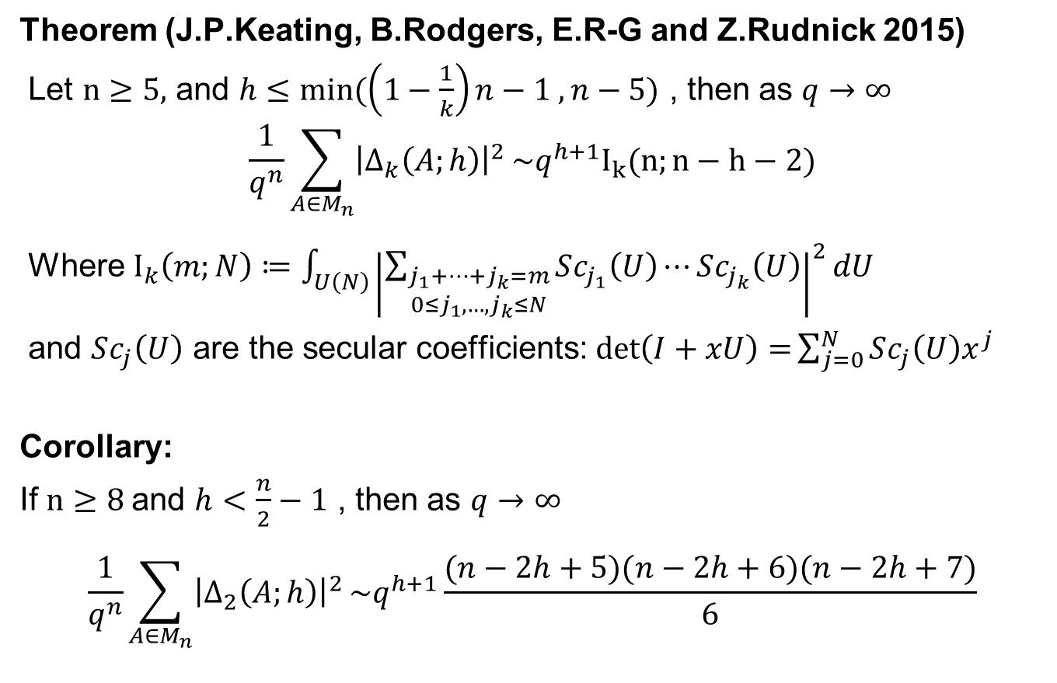
Variance in short intervals
Theorem (J.P.Keating, B.Rodgers, E.R-G and Z.Rudnick 2015)
Let $n≥5,$ and $h≤min⁡(\left(1−\frac{1}{k}\right)n−1 , n−5)$ , then as $q→∞$
$$\frac{1}{q^{n}}\sum_{A∈M_{n}}{{\left|Δ_{k}\left(A;h\right)\right|}^{2}}\sim q^{h+1}I_{k}(n;n−h−2)$$
Where $I_{k}\left(m;N\right)≔\int_{U\left(N\right)}{{\left|\sum_{\begin{aligned}j_{1}+⋯+j_{k}=m \\ 0≤j_{1},…,j_{k}≤N\end{aligned}}{Sc_{j_{1}}\left(U\right)⋯Sc_{j_{k}}\left(U\right)}\right|}^{2}dU}$
and $Sc_{j}\left(U\right)$ are the secular coefficients: $\det\left(I+xU\right)=\sum_{j=0}^{N}{Sc_{j}\left(U\right)x^{j}}$
Corollary:
If $n≥8$and $h<\frac{n}{2}−1$ , then as $q→∞$
$$\frac{1}{q^{n}}\sum_{A∈M_{n}}{{\left|Δ_{2}\left(A;h\right)\right|}^{2}}\sim q^{h+1}\frac{(n−2h+5)(n−2h+6)(n−2h+7)}{6}$$

Slide 14
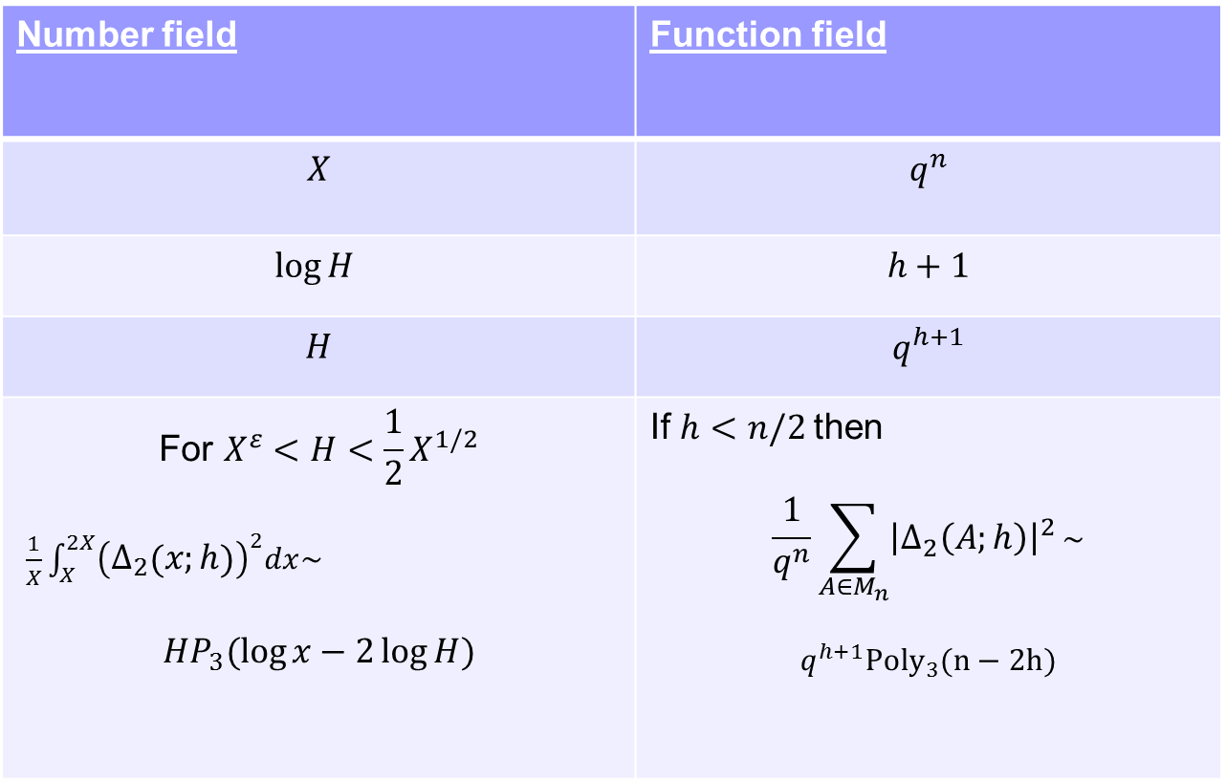
Comparison between number field and function field results (short intervals)
Number field | Function field
$$X$$ | $$q^{n}$$
$$\log{H }$$ | $$h+1$$
$$H$$ | $$q^{h+1}$$
$$\text{For} X^{ε}<H<\frac{1}{2}X^{1/2}$$ $\frac{1}{X}\int_{X}^{2X}{{\left(Δ_{2}\left(x;h\right)\right)}^{2}dx\sim }$ $$HP_{3}(\log{x−2\log{H}})$$ | If $h<n/2$then $$\frac{1}{q^{n}}\sum_{A∈M_{n}}{{\left|Δ_{2}\left(A;h\right)\right|}^{2}}\sim$$ $$q^{h+1}{Poly}_{3}(n−2h)$$

Slide 15
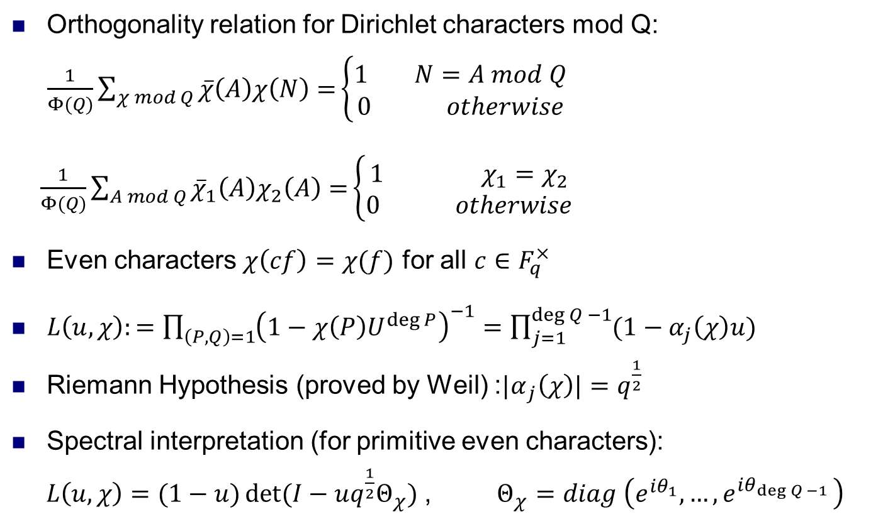
Ingredients of the proof
Orthogonality relation for Dirichlet characters mod Q:
$\frac{1}{Φ(Q)}\sum_{χ mod Q}{\overline{χ}\left(A\right)χ\left(N\right)=}\left\{\begin{aligned}1 N=A mod Q \\ 0 otherwise\end{aligned}\right.$
$\frac{1}{Φ(Q)}\sum_{A mod Q}{{\overline{χ}}_{1}\left(A\right)χ_{2}\left(A\right)=}\left\{\begin{aligned}1 χ_{1}=χ_{2} \\ 0 otherwise\end{aligned}\right.$
Even characters $χ\left(cf\right)=χ(f)$ for all $c∈F_{q}^{×}$
$L\left(u,χ\right):=\prod_{\left(P,Q\right)=1}{{\left(1−χ\left(P\right)U^{\deg{P}}\right)}^{−1}}=\prod_{j=1}^{\deg{Q −1}}{(1−α_{j}\left(χ\right)u)}$
Riemann Hypothesis (proved by Weil) :${|α}_{j}\left(χ\right)|=q^{\frac{1}{2}}$
Spectral interpretation (for primitive even characters):
$L\left(u,χ\right)=(1−u)\det{(I−uq^{\frac{1}{2}}Θ_{χ})}$ , $Θ_{χ}=diag \left(e^{iθ_{1}},…,e^{iθ_{\deg{Q −1 }}}\right)$

Slide 16
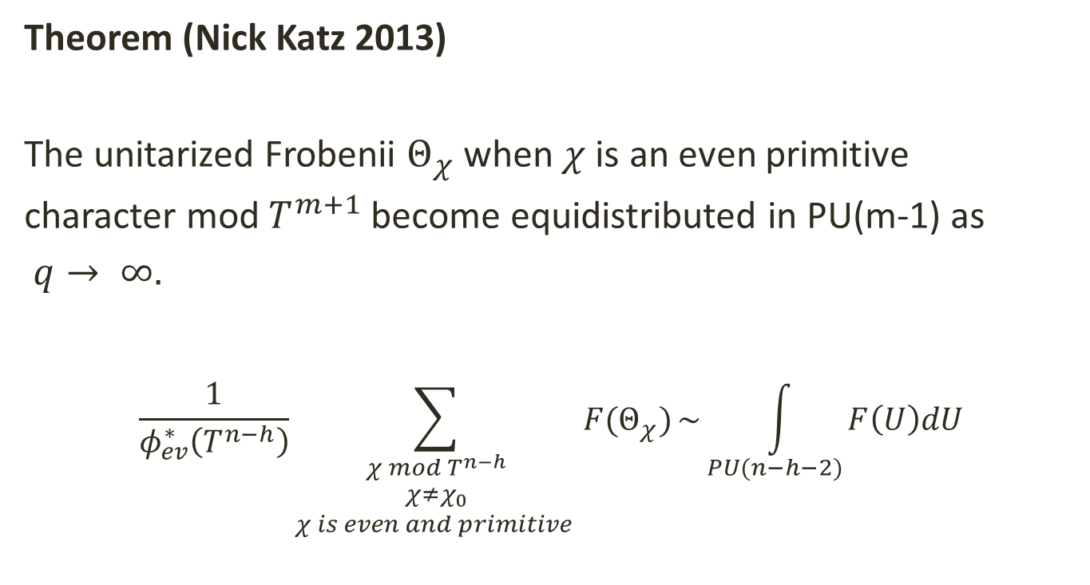
The main ingredient
Theorem (Nick Katz 2013)
The unitarized Frobenii $Θ_{χ}$ when $χ$is an even primitive
character mod $T^{m+1}$ become equidistributed in PU(m-1) as
$q→ ∞.$
$$\frac{1}{φ_{ev}^{∗}\left(T^{n−h}\right)}\sum_{\begin{aligned}χ mod T^{n−h} \\ χ≠χ_{0} \\ χ is even and primitive \end{aligned}}{F(Θ_{χ})}\sim \int_{PU(n−h−2)}{F\left(U\right)dU}$$

Slide 17
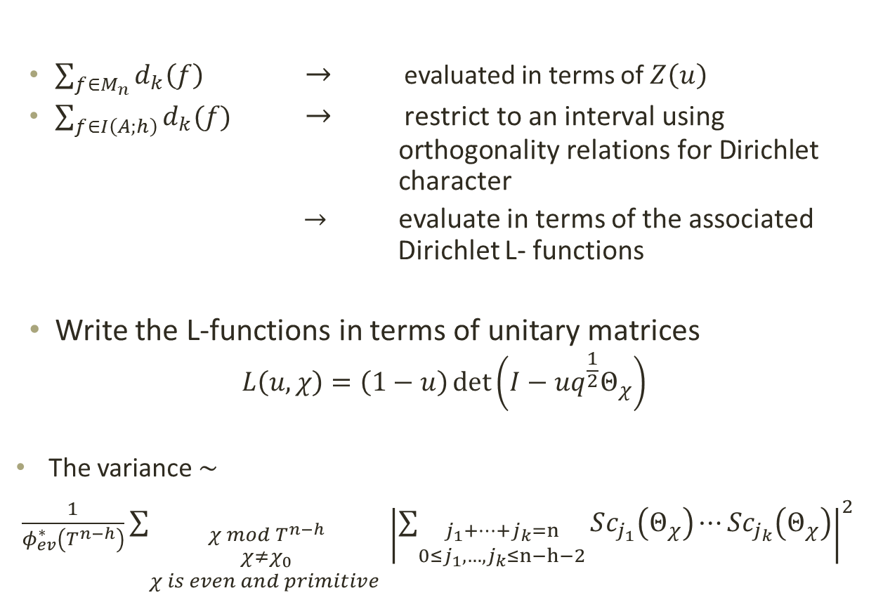
Sketch of the proof
$\sum_{f∈M_{n}}{d_{k}\left(f\right)}$ $→$ evaluated in terms of $Z\left(u\right)$
$\sum_{f∈I\left(A;h\right)}{d_{k}(f)}$ $→$ $\text{restrict} \text{to} \text{an} \text{interval} \text{using} \text{orthogonality} \text{relations} \text{for} \text{Dirichlet} \text{character}$
$→$ evaluate in terms of the associated Dirichlet L- functions
Write the L-functions in terms of unitary matrices
$$L\left(u,χ\right)=\left(1−u\right)\det\left(I−uq^{\frac{1}{2}}Θ_{χ}\right)$$
The variance $\sim$
$\frac{1}{φ_{ev}^{∗}\left(T^{n−h}\right)}\sum_{\begin{aligned}χ mod T^{n−h} \\ χ≠χ_{0} \\ χ is even and primitive \end{aligned}}{{\left|\sum_{\begin{aligned}j_{1}+⋯+j_{k}=n \\ 0≤j_{1},…,j_{k}≤n−h−2\end{aligned}}{Sc_{j_{1}}\left(Θ_{χ}\right)⋯Sc_{j_{k}}\left(Θ_{χ}\right)}\right|}^{2}}$

Slide 18
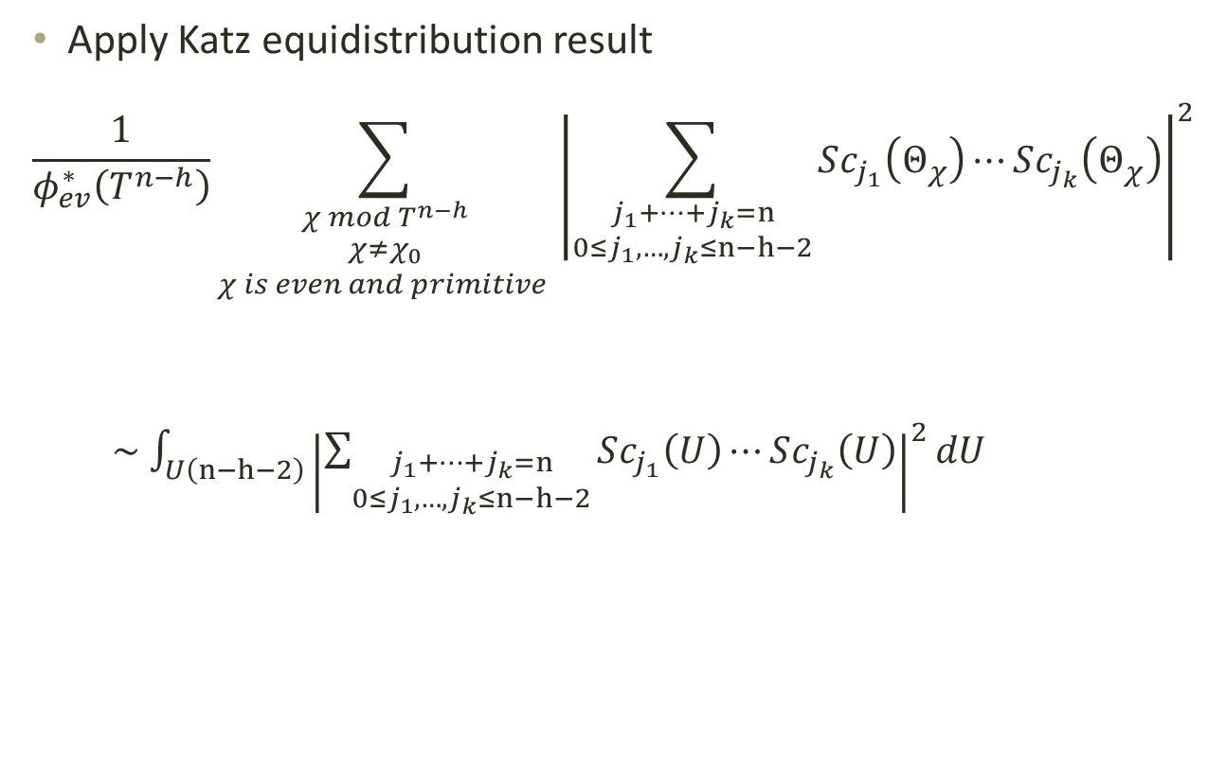
Sketch of the proof
Apply Katz equidistribution result
$$\frac{1}{φ_{ev}^{∗}\left(T^{n−h}\right)}\sum_{\begin{aligned}χ mod T^{n−h} \\ χ≠χ_{0} \\ χ is even and primitive \end{aligned}}{{\left|\sum_{\begin{aligned}j_{1}+⋯+j_{k}=n \\ 0≤j_{1},…,j_{k}≤n−h−2\end{aligned}}{Sc_{j_{1}}\left(Θ_{χ}\right)⋯Sc_{j_{k}}\left(Θ_{χ}\right)}\right|}^{2}}$$
$\sim$ $\int_{U\left(n−h−2\right)}{{\left|\sum_{\begin{aligned}j_{1}+⋯+j_{k}=n \\ 0≤j_{1},…,j_{k}≤n−h−2\end{aligned}}{Sc_{j_{1}}\left(U\right)⋯Sc_{j_{k}}\left(U\right)}\right|}^{2}dU}$

Slide 19
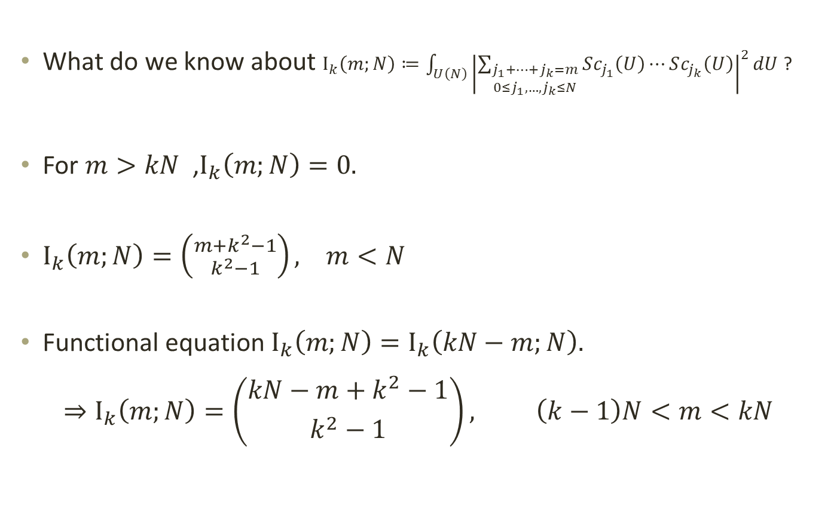
Matrix Integral
What do we know about $I_{k}\left(m;N\right)≔\int_{U\left(N\right)}{{\left|\sum_{\begin{aligned}j_{1}+⋯+j_{k}=m \\ 0≤j_{1},…,j_{k}≤N\end{aligned}}{Sc_{j_{1}}\left(U\right)⋯Sc_{j_{k}}\left(U\right)}\right|}^{2}dU}$ ?
For $m>kN$ ,$I_{k}\left(m;N\right)=0.$
$I_{k}\left(m;N\right)=\left({m+k^{2}−1 \atop k^{2}−1}\right), m<N$
Functional equation $I_{k}\left(m;N\right)=I_{k}\left(kN−m;N\right).$
$$⇒I_{k}\left(m;N\right)=\left({kN−m+k^{2}−1 \atop k^{2}−1}\right), \left(k−1\right)N<m<kN$$

Slide 20
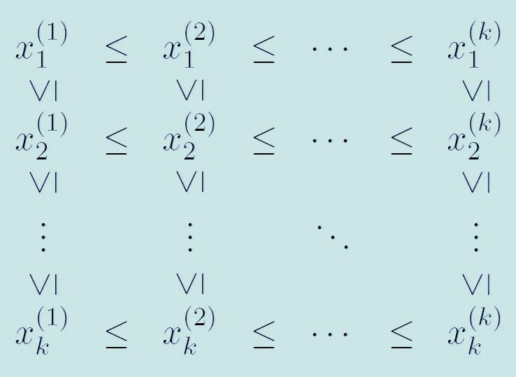

Theorem (J.P.Keating, B.Rodgers, ER-G and Z.Rudnick)
$I_{k}\left(m;N\right)$ is equal to the count of lattice points $x=(x_{i}^{\left(j\right)})∈{(ℤ)}^{k^{2}}$ satisfying each of the relations
$0≤x_{i}^{\left(j\right)}≤N$ for all $1≤i,j≤k.$
$x_{1}^{\left(k\right)}+x_{2}^{\left(k−1\right)}+⋯+x_{k}^{\left(1\right)}=kN−m.$
$x∈A_{k}$, where $A_{k}$ is the collection of $k×k$ matrices whose entries satisfy the following system of equalities,

Slide 21
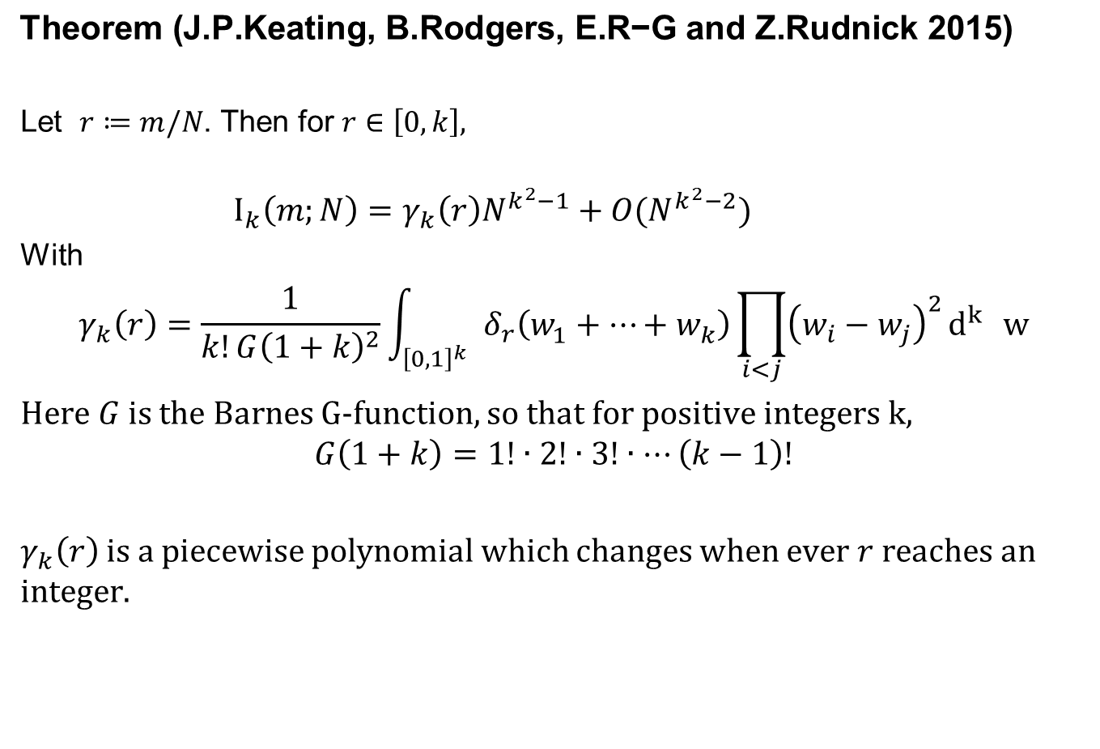
$$\text{Theorem}\text{ (}\text{J}\text{.}\text{P}\text{.}\text{Keating}\text{, }\text{B}\text{.}\text{Rodgers}\text{, }\text{E}\text{.}\text{R}\text{−}\text{G} \text{and} \text{Z}\text{.}\text{Rudnick} \text{2015}\text{)}$$
Let $r≔m/N$. Then for $r∈\left[0,k\right],$
$$I_{k}\left(m;N\right)=γ_{k}\left(r\right)N^{k^{2}−1}+O(N^{k^{2}−2})$$
With
$$γ_{k}\left(r\right)=\frac{1}{k!G{\left(1+k\right)}^{2}}\int_{{\left[0,1\right]}^{k} }{δ_{r}\left(w_{1}^{}+⋯+w_{k}^{}\right)\prod_{i<j}{{\left(w_{i}−w_{j}\right)}^{2}}d^{k^{}}w}$$
Here $G$ is the Barnes G-function, so that for positive integers k,
$$G\left(1+k\right)=1!∙2!∙3!∙⋯\left(k−1\right)!$$
$γ_{k}\left(r\right)$ is a piecewise polynomial which changes when ever $r$reaches an integer.

Slide 22
Thank you!

